Slide 1
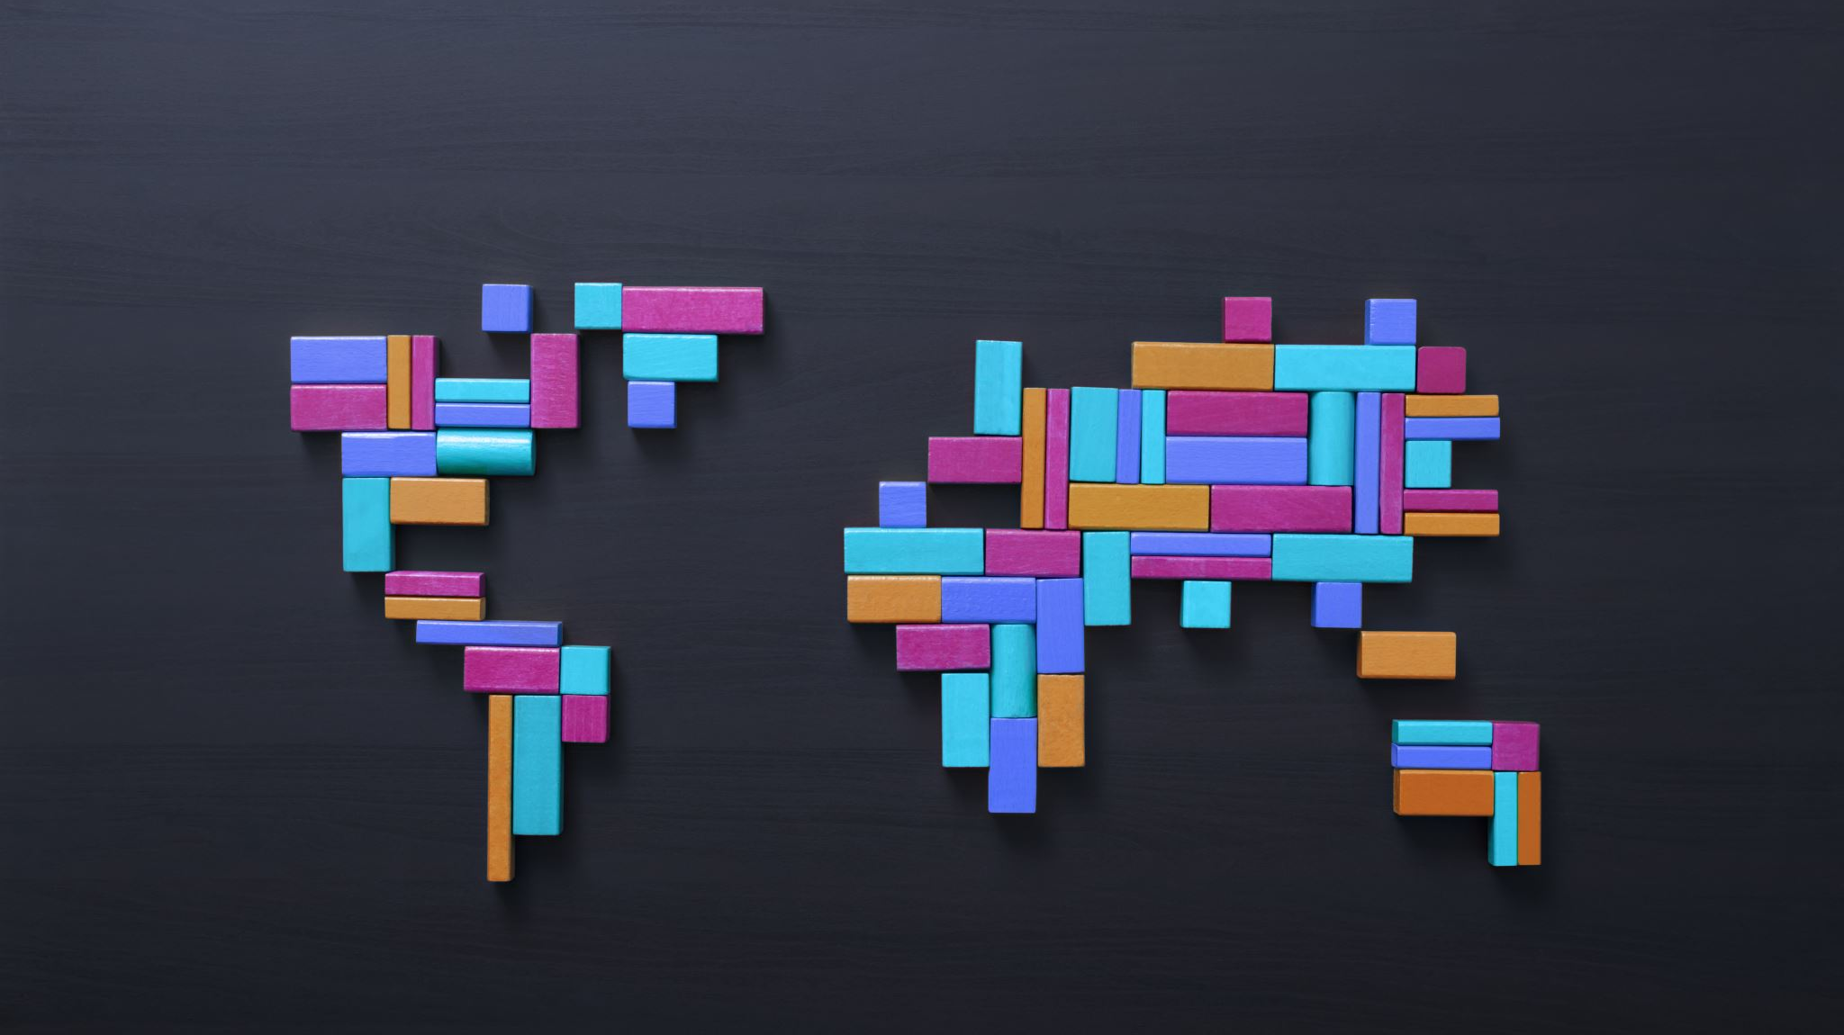
Segmenting Color Images of Cats using Clustering Algorithms
By Carlos Guzman

Slide 2
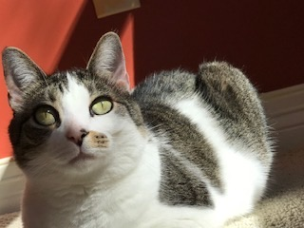
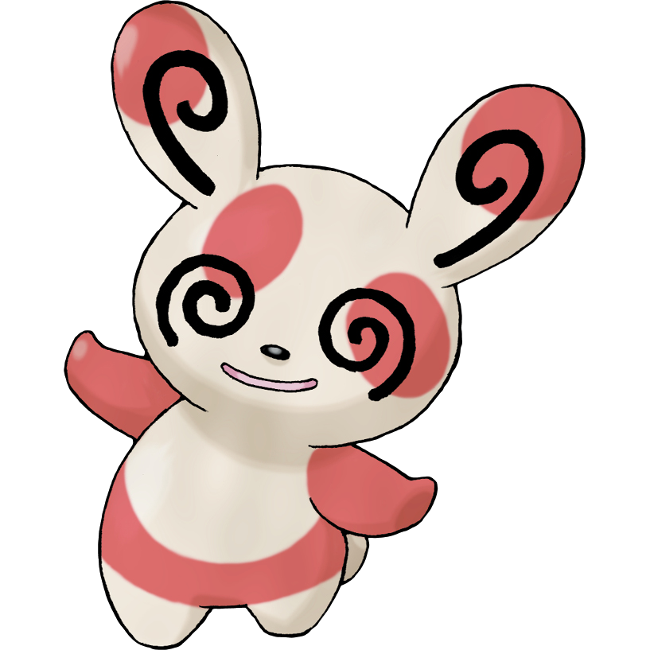
Why cat images?
Family and friends have a billion pictures of their cats.
I began noticing they are very colorful and with unique patterns.
Patterns reminded me of the pokemon Spinda
Each Spinda has a unique pattern.
Chanches of two identical Spindas is < 1 in 4 billion
I’ve never seen two cats with identical coats.

Slide 3
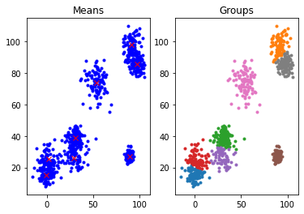
Clustering Algorithms
Implemented 3 clustering algorithms
K-Means
K-Means++
DBSCAN
14 images of cats
5 Different cats
Feature Vector
1st: Channel
2nd: Added Spatial Features (Pixel Locations)

Slide 4
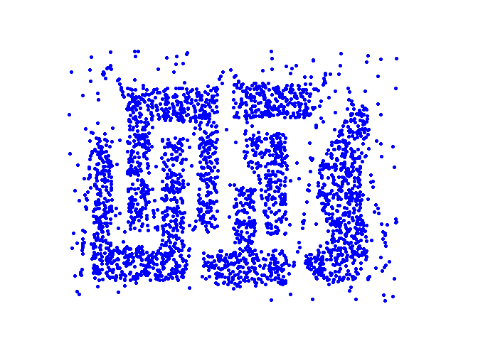
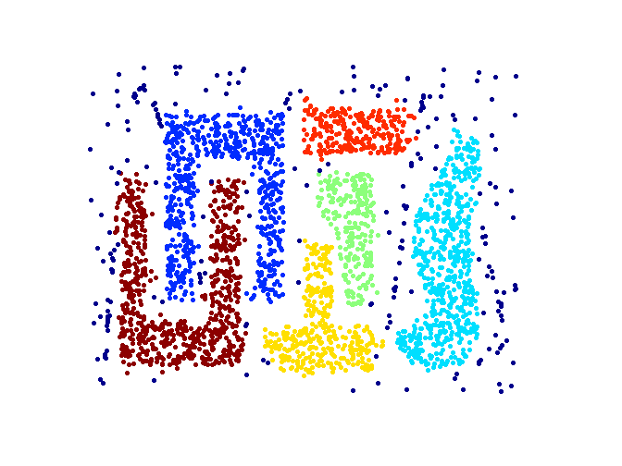
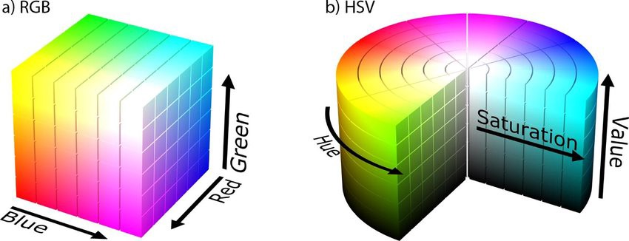
Other methods used
Filter the image with a low pass filter to smooth out the fur.
Changed to HSV color space for DBSCAN to measure similarity between colors.
Comparing similar colors
Color similarity, Cosine Similarity, Euclidean Distance
Used City-Block Distance to find neighbors.

Slide 5
Results
K=8 for all images.
The script took ~3 days to finish.
Many factors impacted results
K-Means is sensitive to noise & cluster shapes
Shadows, objects in background, different intensities.

Slide 6
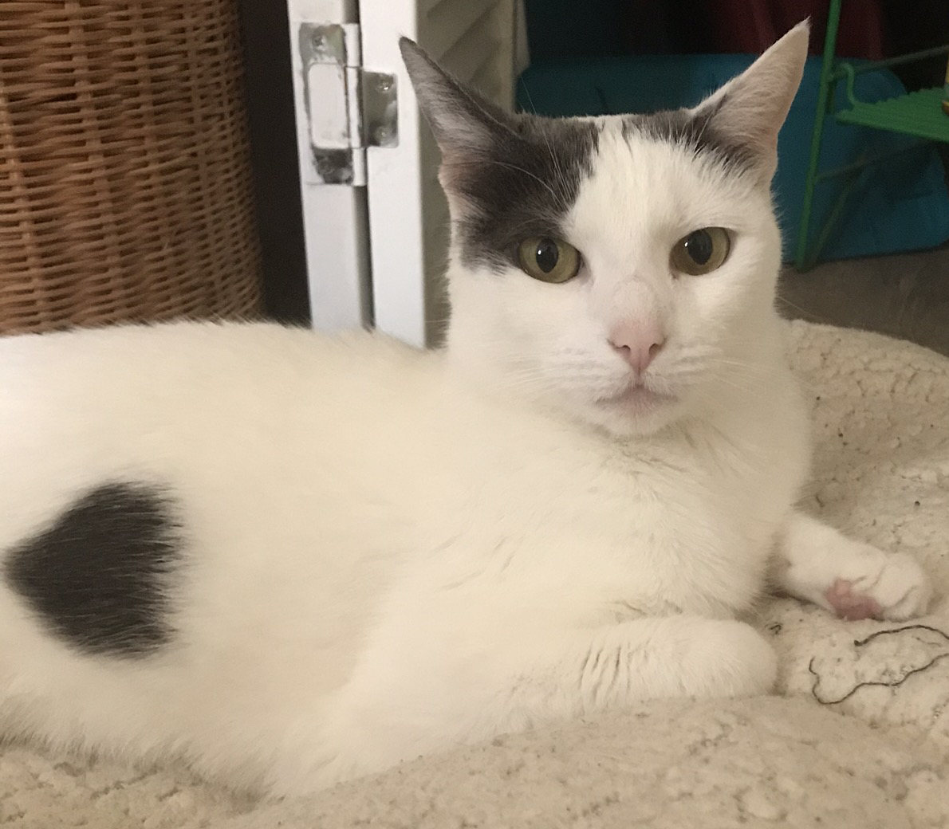
Tina

Slide 7
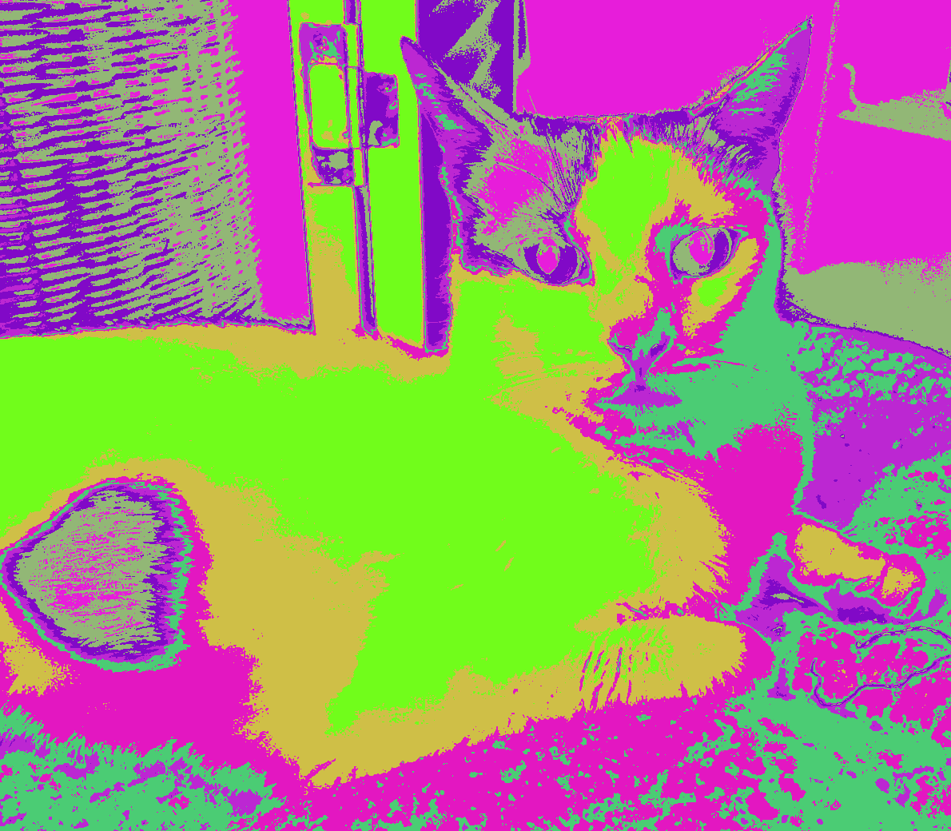
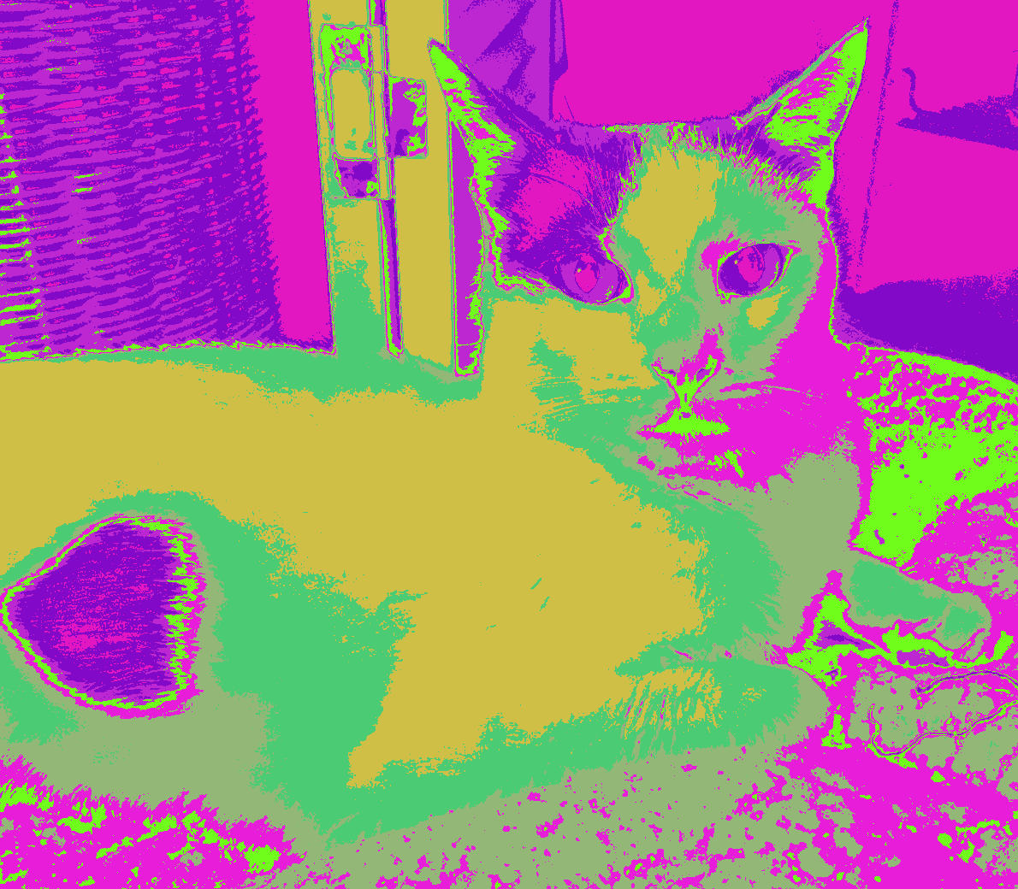
Tina
K-Means
K-Means++

Slide 8
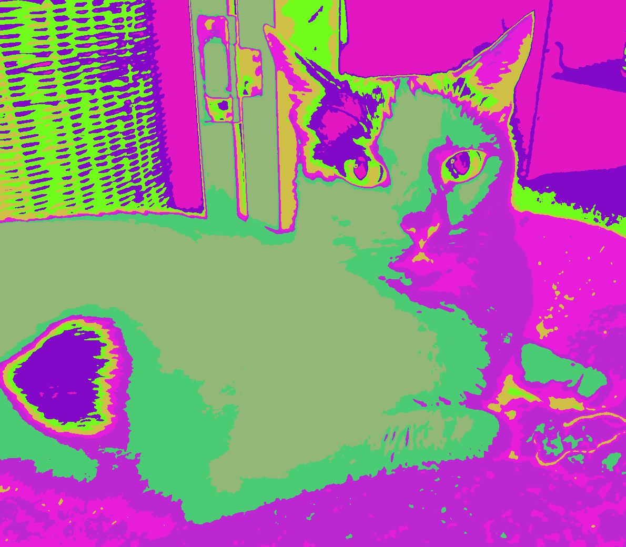
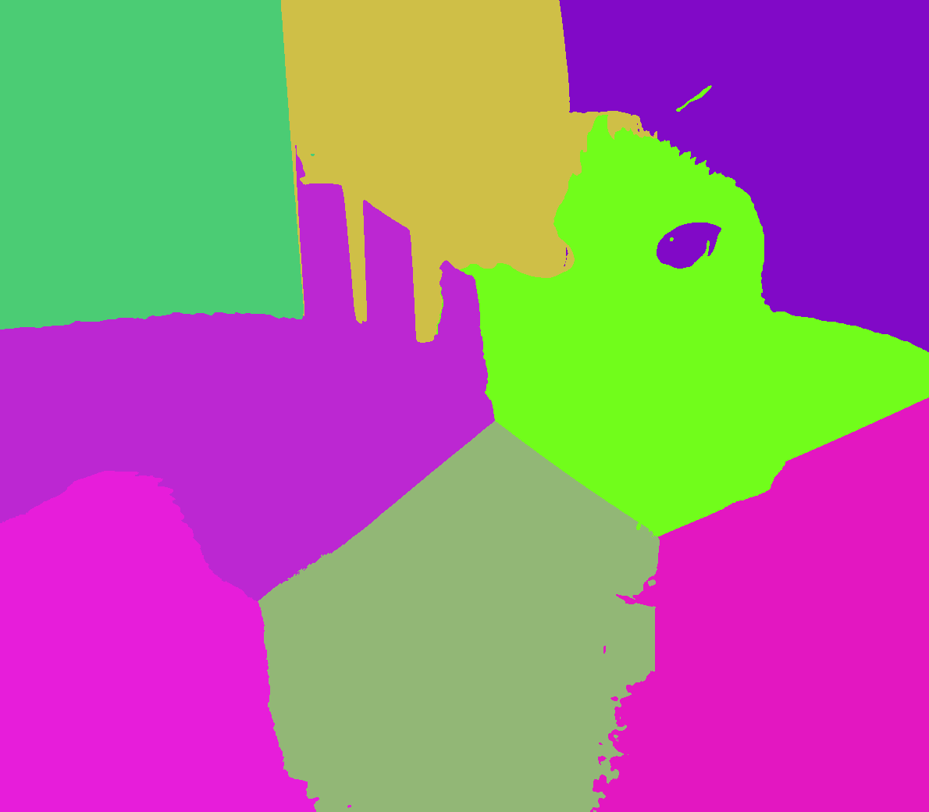
Tina
Blurring image & K-Means++
Adding Spatial Features

Slide 9
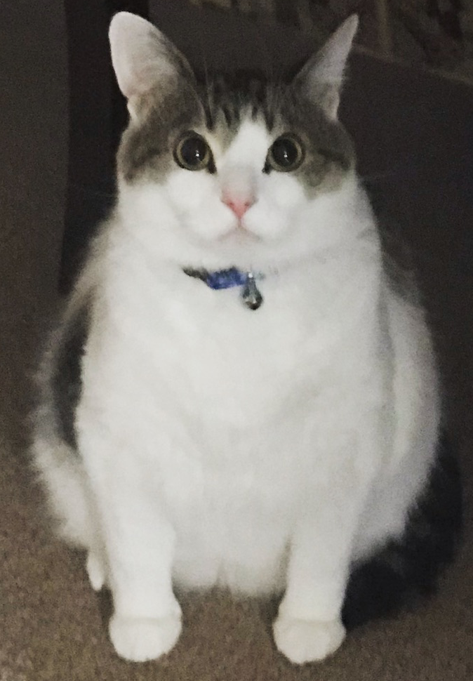
Jojo

Slide 10
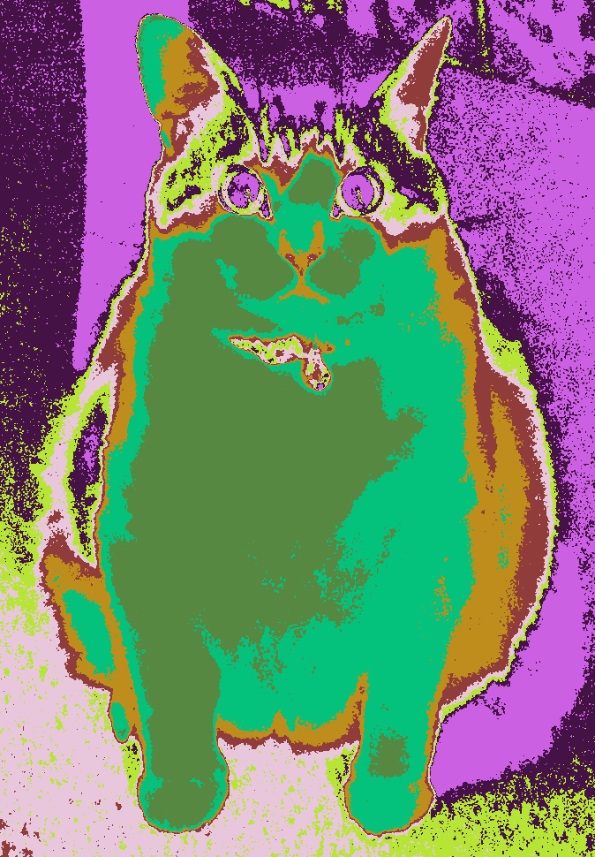
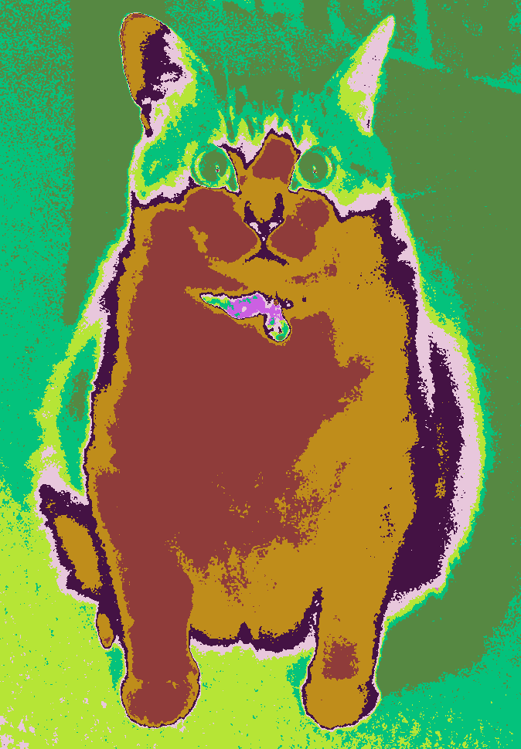
Jojo
K-Means
K-Means++

Slide 11
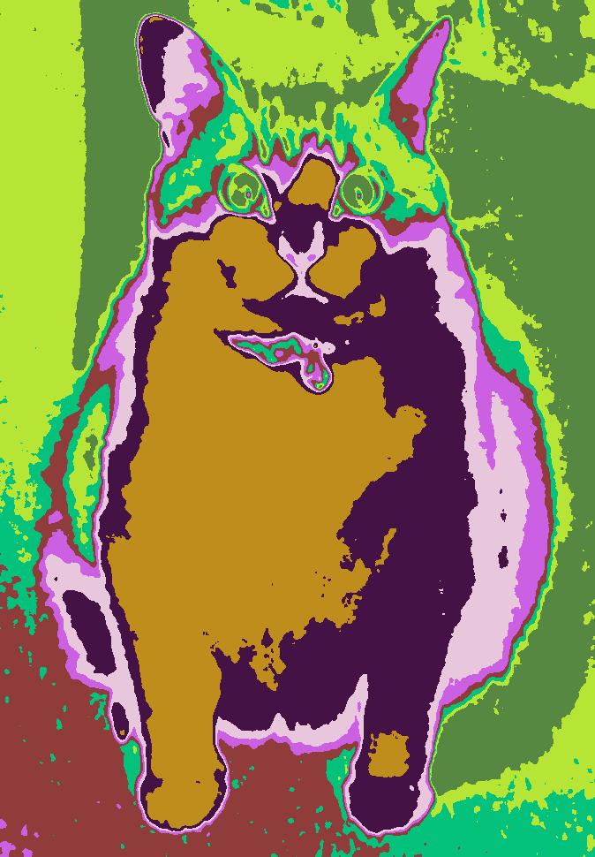
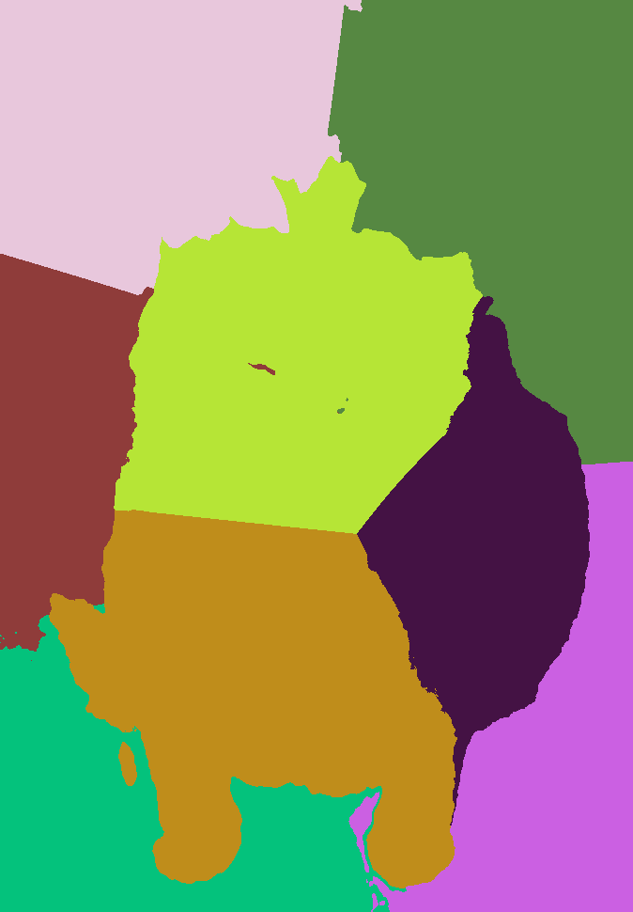
Jojo
Blurring image & K-Means++
Adding Spatial Features

Slide 12
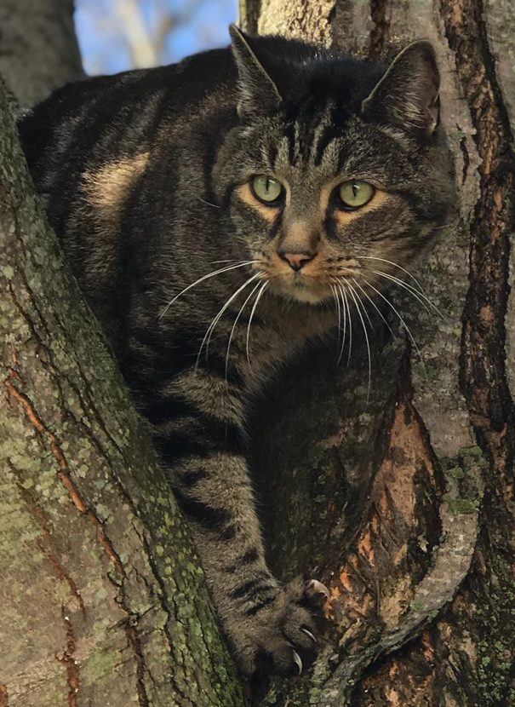
Stretch

Slide 13
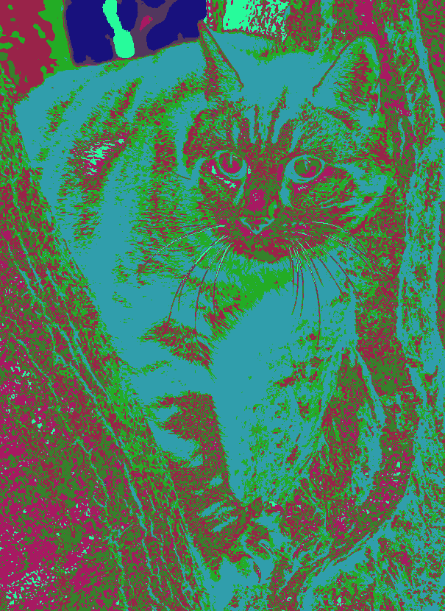
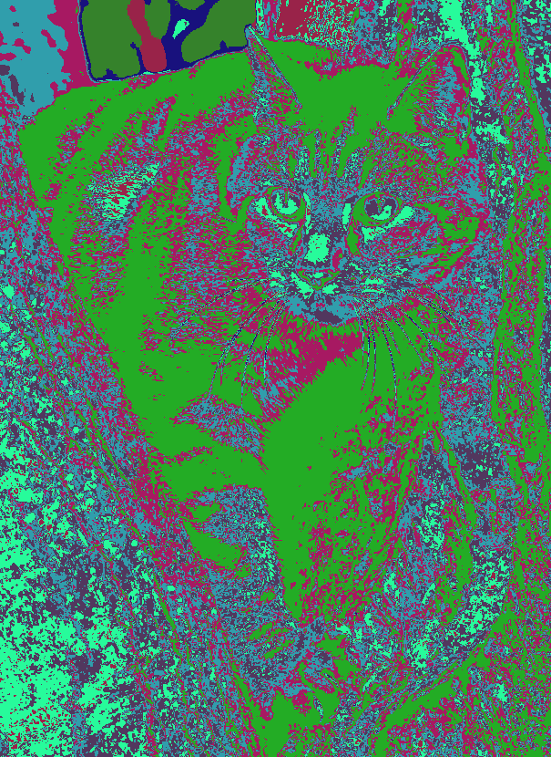
Stretch
K-Means
K-Means++

Slide 14
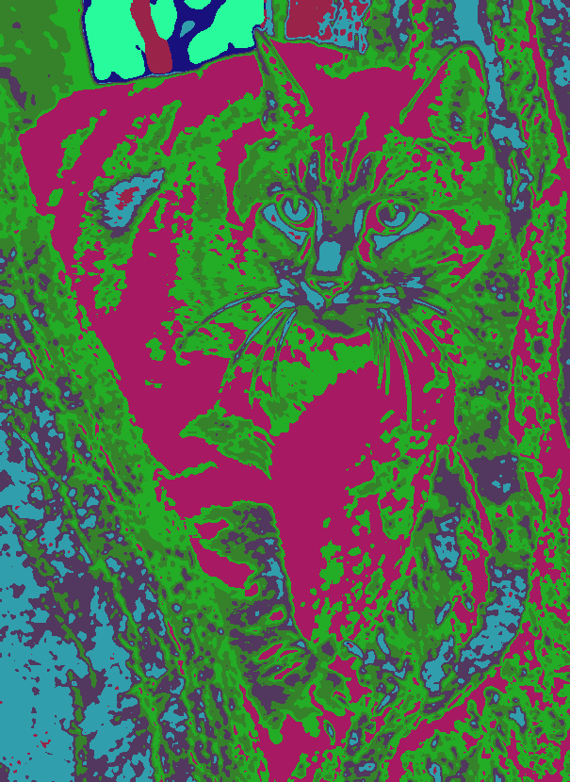
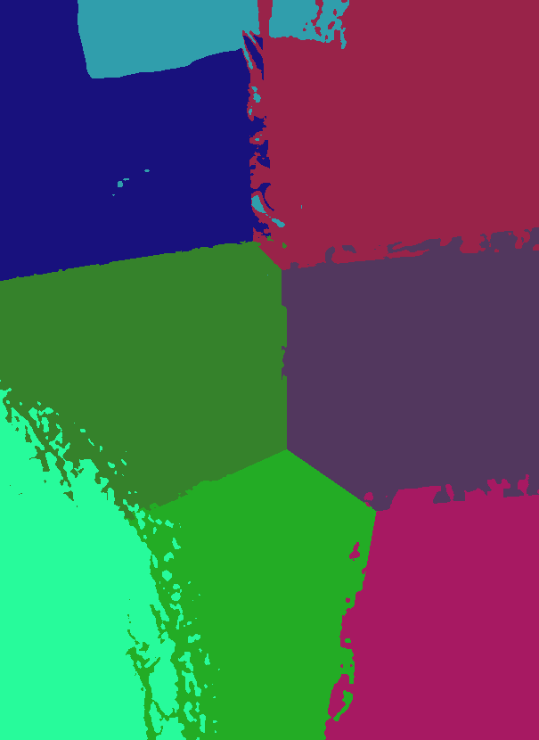
Stretch
Blurring image & K-Means++
Adding Spatial Features

Slide 15

Thank You!

